Slide 1
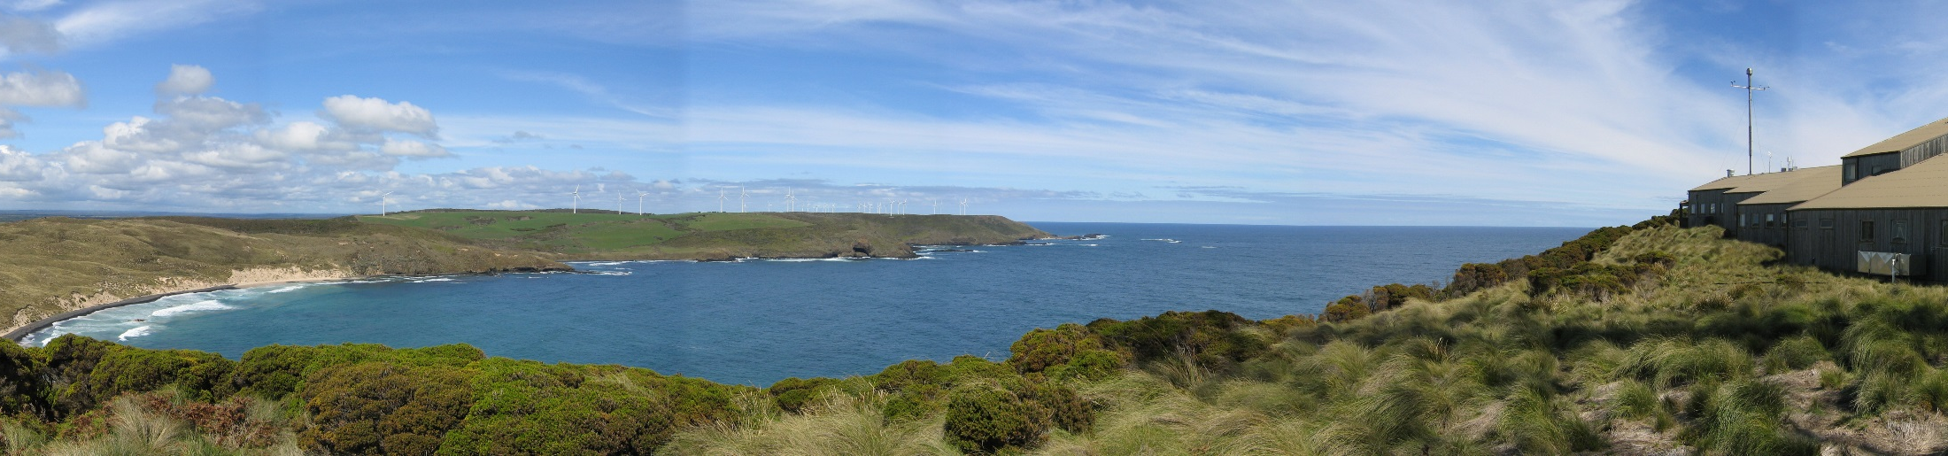
Update on ACCESS-CM2 CMIP6 simulations
CSIRO Climate Science Centre
Martin Dix| Coupled climate modelling team

Slide 2
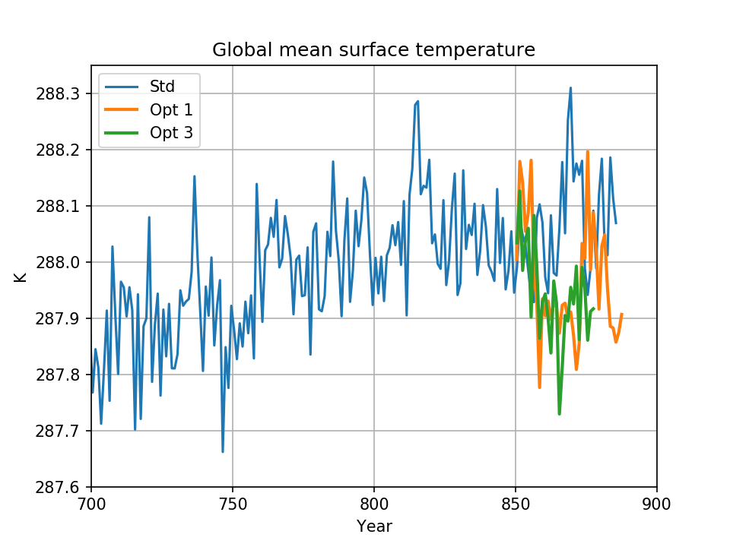
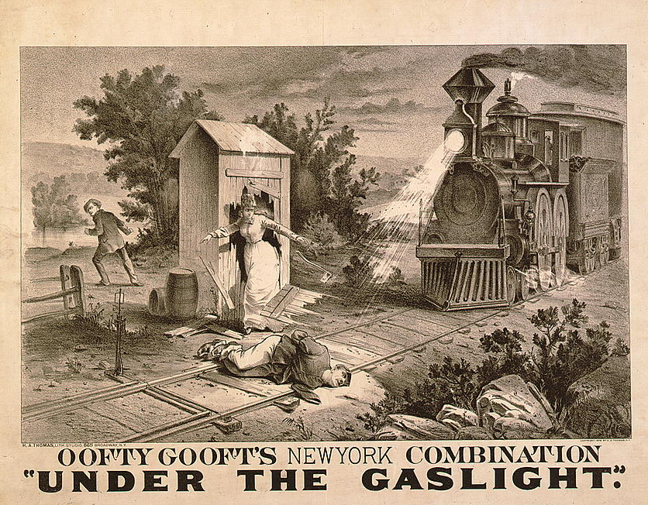
In our last exciting episode …
PI control had just been restarted because of various aerosol related issues
Option 1 minimal fixes
Option 3 preferred version with some extra fixes
Notes:
Last Science Day was May 23
Option 1. Wind speed + dry deposition fix
Option 3. Also salt aerosol mass fix and remove 2% ocean albedo

Slide 3
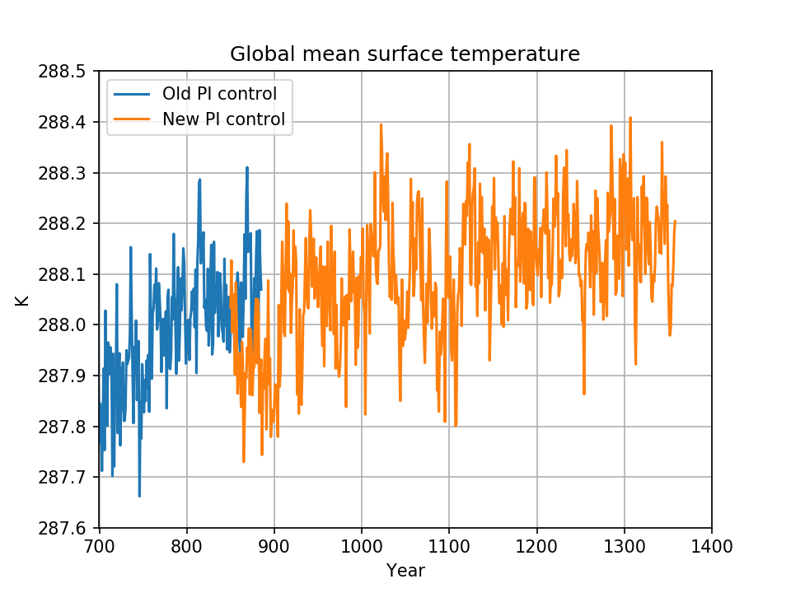
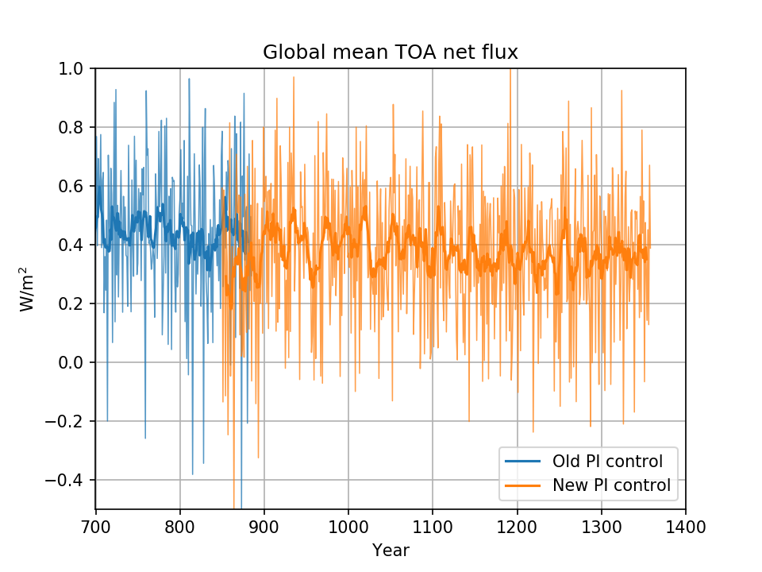
New PI control (option 3)
Official CMIP6 run starts at year 950
Notes:
Note that this is the green line from the previous slide

Slide 4
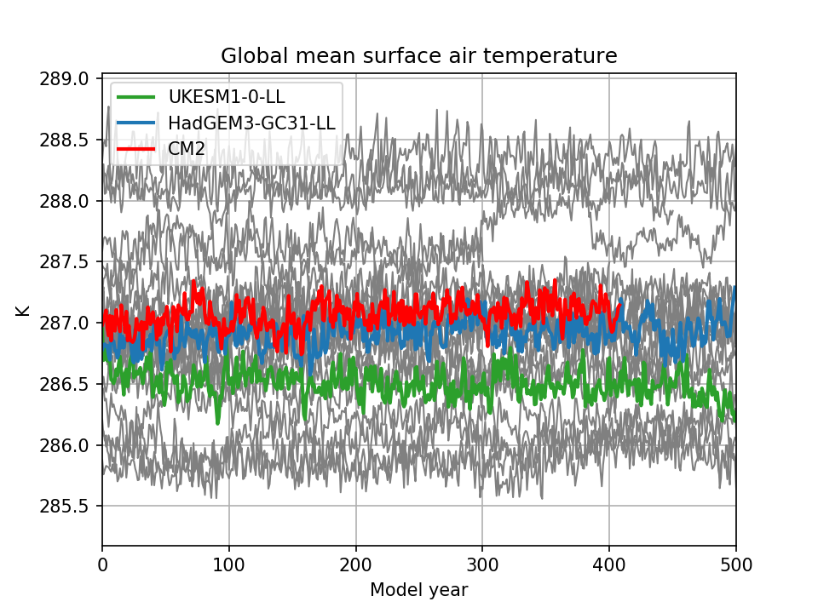
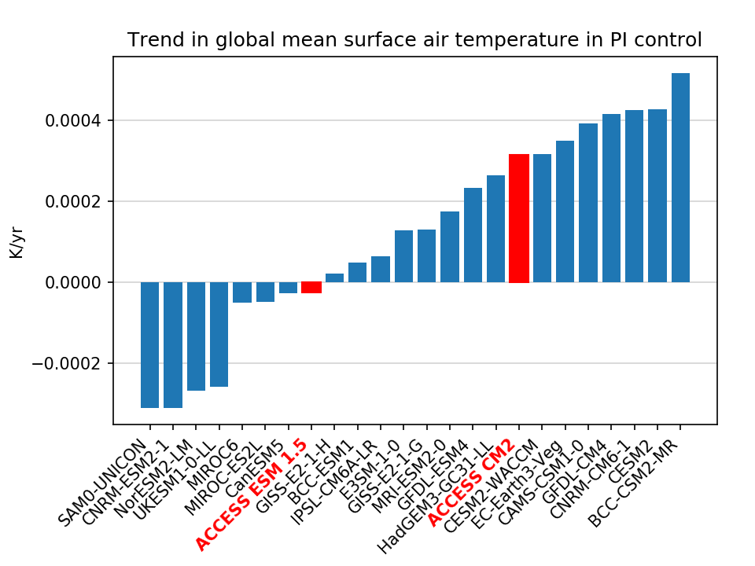
PI control drift compared to other CMIP6 models
Notes:
Hemispheric values look worse. Damien will say something on energy balances

Slide 5
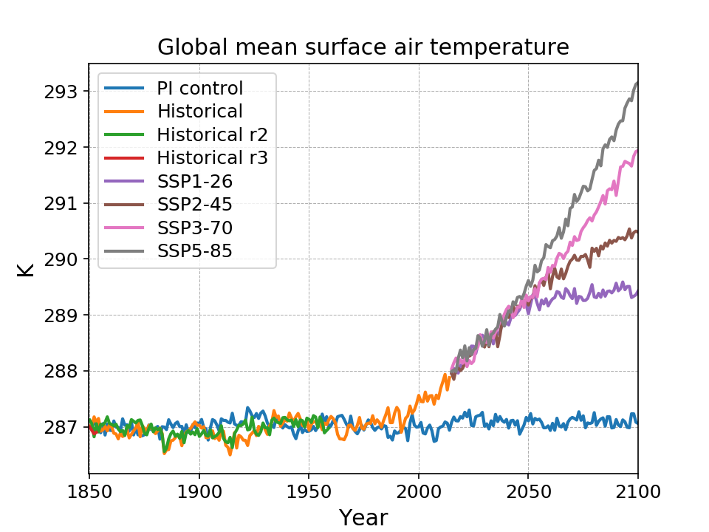
Current status
In progress
PIcontrol
Historical r2 & r3
Will all complete before raijin shutdown
and gadi transition

Slide 6
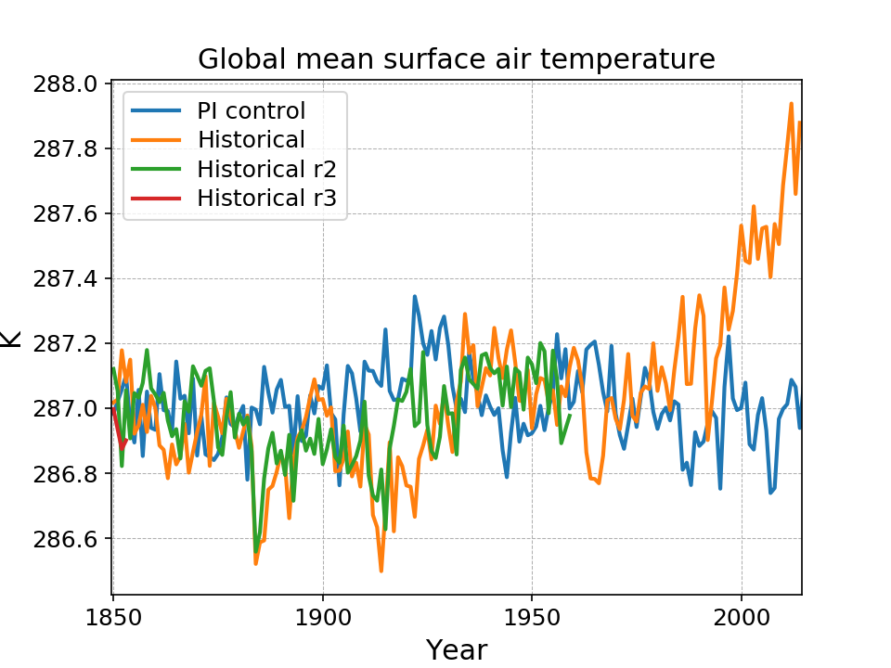
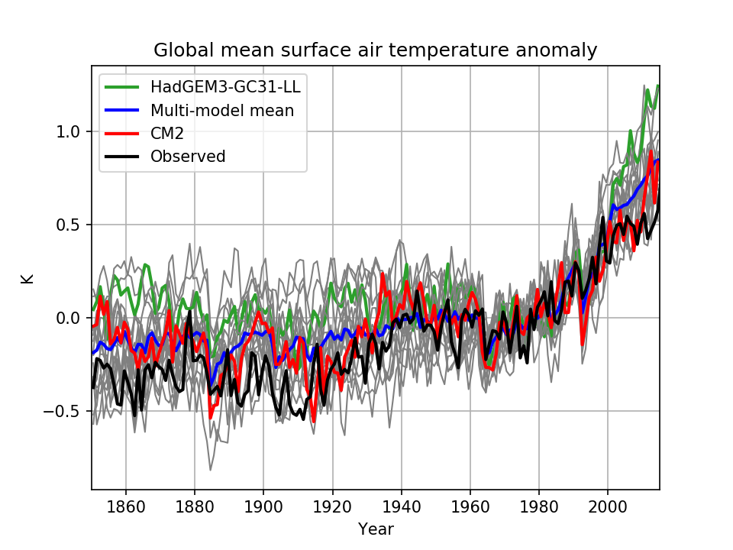
Historical
Anomalies relative to 1961-1990 mean
Control drift over historical period removed
Notes:
Bigger volcanic response than HadGEM3

Slide 7
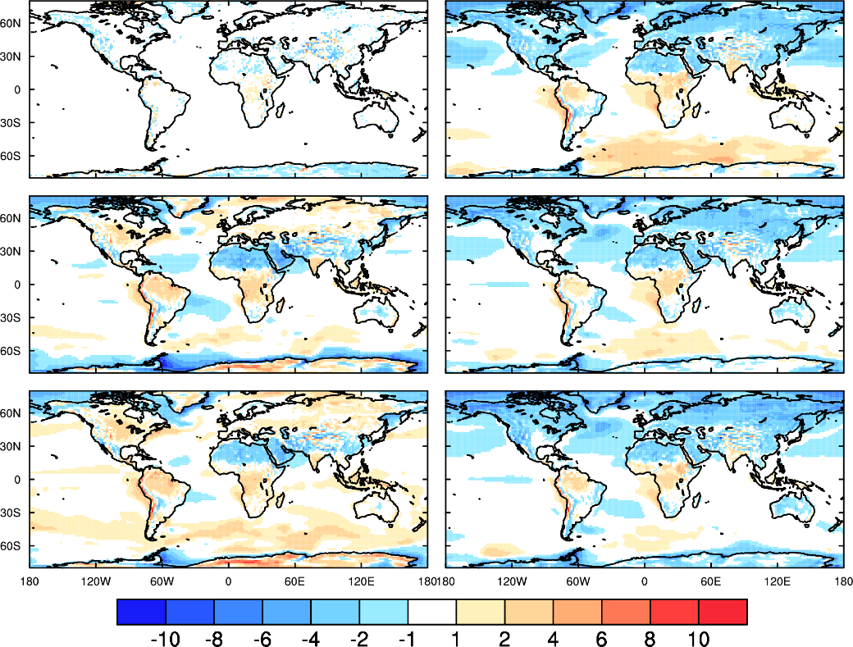
Surface air temperature error wrt ERAi (Ian Watterson)
ERA5
ACCESS CM2
ACCESS 1.3
HadGEM3-GC3.1
ACCESS
ESM 1.5
UKESM

Slide 8
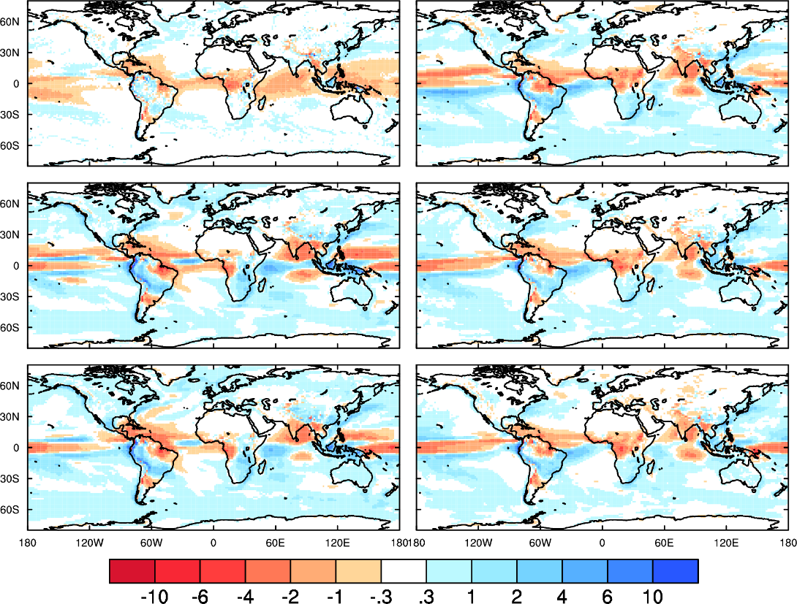
Precipitation error wrt ERAi (Ian Watterson)
ERA5
ACCESS CM2
ACCESS 1.3
HadGEM3-GC3.1
ACCESS
ESM 1.5
UKESM

Slide 9
M score wrt ERAi (Ian Watterson)
 | ERA5 | A-1.3 | ESM15 | A-CM2 | HadGC3 | UKESM
tas | 977 | 923 | 926 | 923 | 928 | 918
pr | 783 | 655 | 675 | 679 | 709 | 705
psl | 971 | 845 | 849 | 826 | 834 | 834

Slide 10
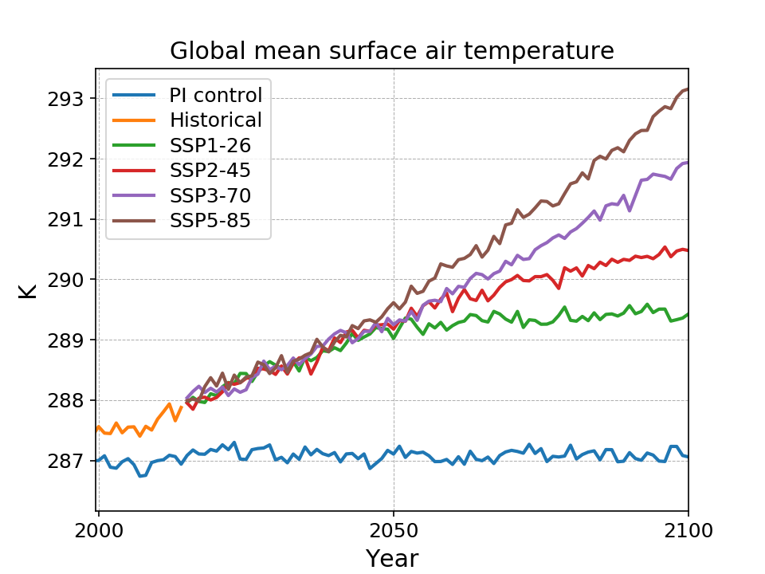
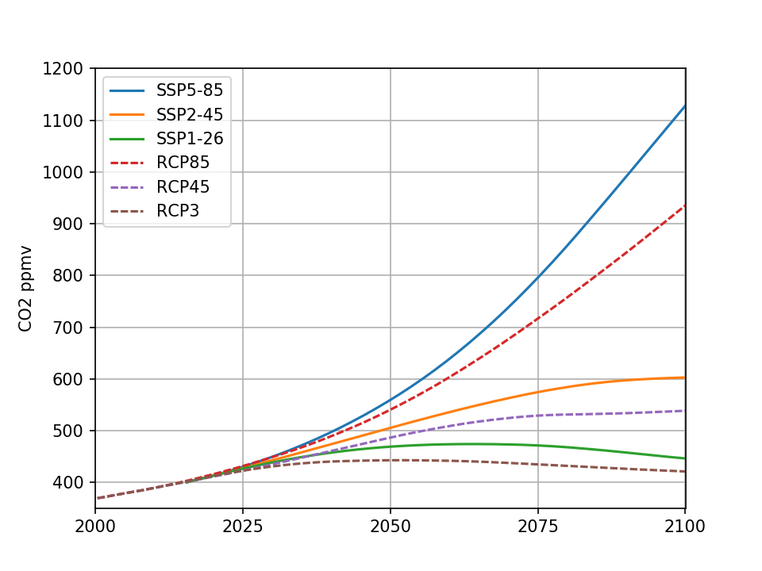
SSPs
CO₂
CO2
Notes:
Add plot from 1960 here. Redo to add 3-70

Slide 11
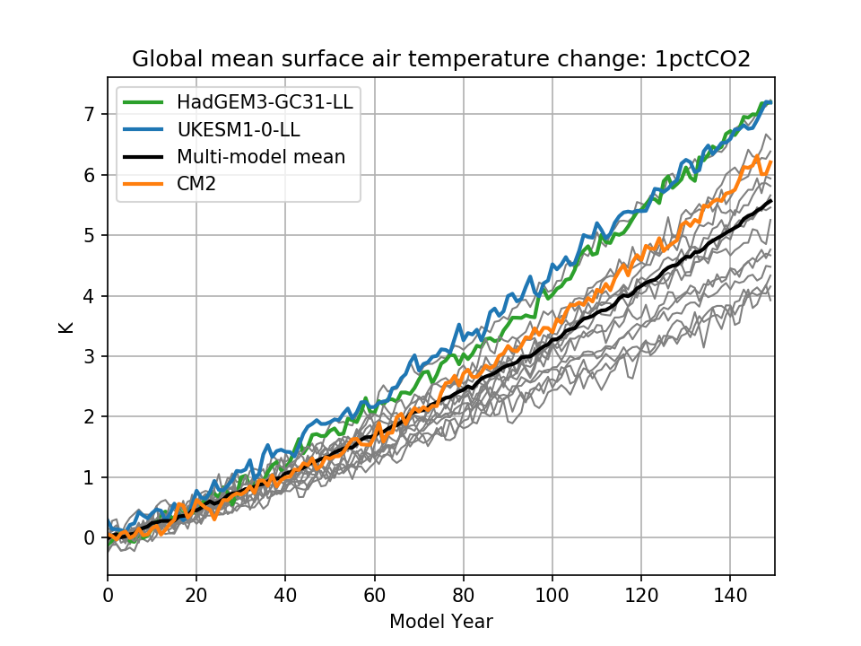
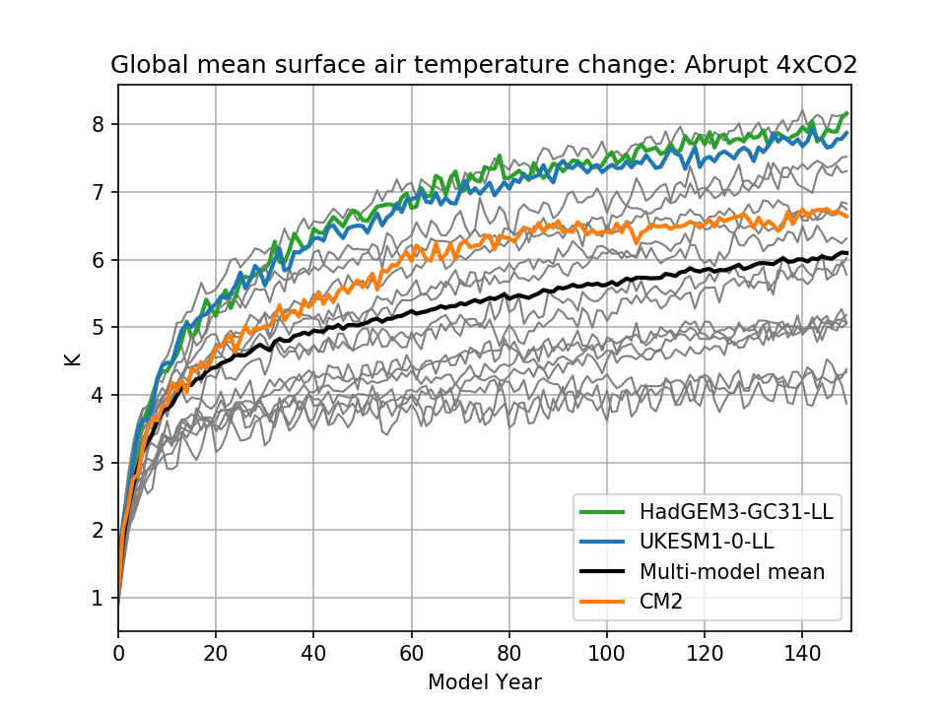
Idealised experiments: 1pctCO2 and 4xCO2

Slide 12
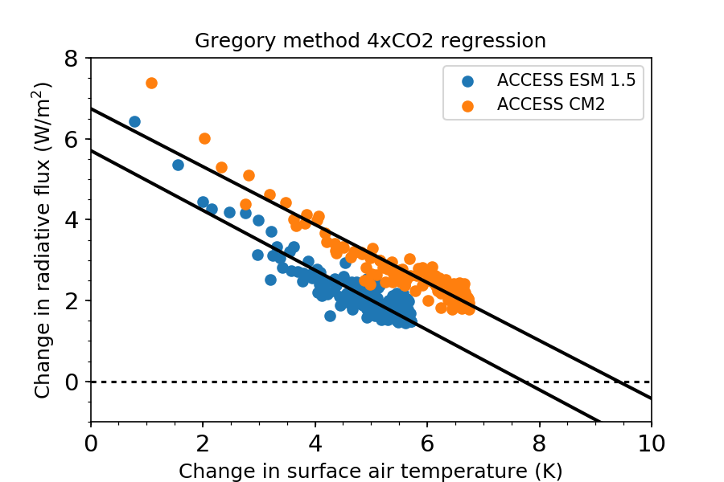
Equilibrium climate sensitivity from 4xCO2
Model | 2xCO2 ECS
ACCESS ESM 1.5 | 3.8
ACCESS CM2 | 4.7
HadGEM3 GC3.1 | 5.2
Notes:
The regression lines for CM2 and ESM are almost parallel. The normal interpretation of this is that the feedbacks are the same and that the difference in sensitivity is due to the larger forcing (y axis intercept) in CM2. I suspect that isn’t quite right here and that the linearity is breaking down for the fast cloud feedback. I need to go back to some of the original papers and think about this some more.

Slide 13
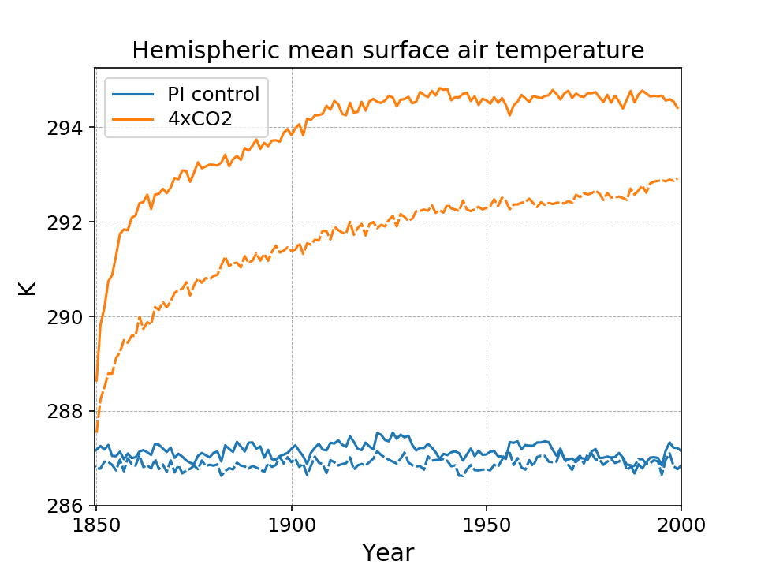
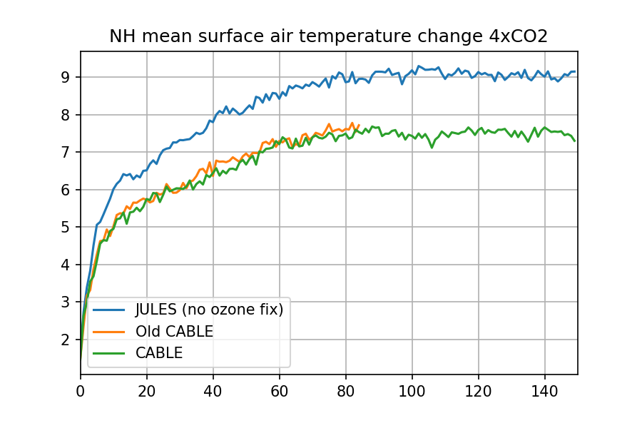
4xCO2
NH stops warming after about 80 years.
Old JULES run without ozone adjustment did the same thing (at the same time, not at the same warming)
Some ocean circulation change?
NH
SH
Notes:
Replot w/o old CABLE but with HadGEM3

Slide 14
Summary
Highest priority runs are complete
(except for last 90 years of piControl)
Data almost ready for publishing on NCI ESG
Extra ensemble members and other MIP runs will be done on gadi
We’ll release a standard configuration of model and suites on gadi
May not be bit comparable to rajiin
Some interesting differences c.f. HadGEM3-GC3.1 we need to understand

